Slide 1
Guidance when decisions matter most
Guidance when decisions matter most

Slide 2
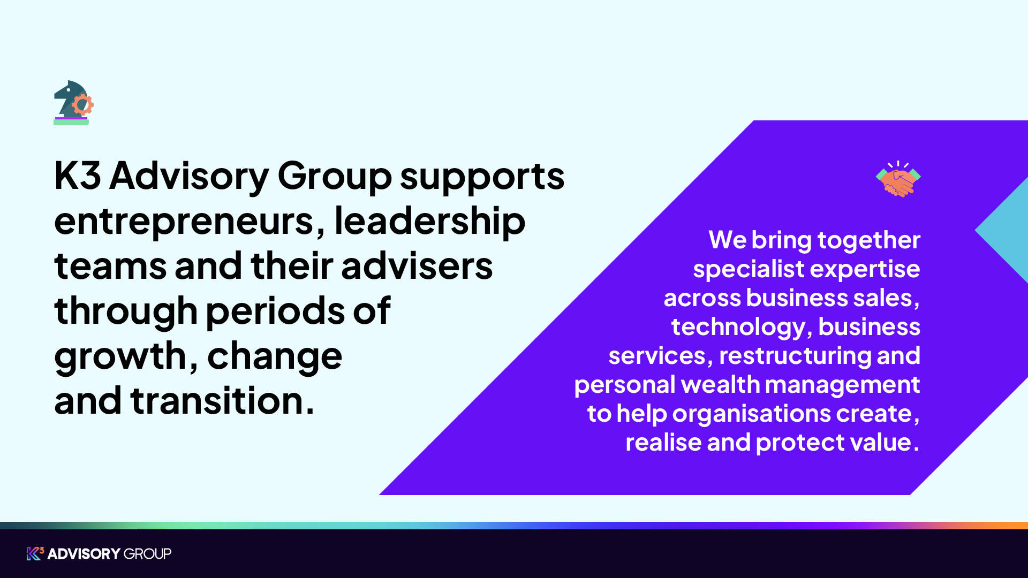

Slide 3

The moments that shape a business rarely arrive with perfect information or unlimited time
Growth, transactions, restructuring, and wealth decisions introduce complexity and pressure when clarity matters most.
Traditional advisory models are siloed, requiring you to manage multiple advisers with conflicting priorities at the point you need joined-up thinking.
Critical decisions get made without understanding how they connect to future value creation, tax efficiency, or personal wealth objectives.
“Disconnected advisers create friction precisely when leadership teams need aligned judgement and pace.”

Slide 4
We help clients create, realise and protect value
Our advice is focused on clear, practical outcomes:
Preparing for growth funding and investment
Navigating challenge, restructuring or recovery
Improving performance, visibility and control
Maximising value from sale, succession or exit
Optimising tax at key points of change
Protecting and planning personal and business wealth

Slide 5

Business growth, funding and scale advisory
Growth takes many forms. For some businesses it means launching and finding product-market fit. For others it means expanding into new markets, strengthening systems, raising capital or pursuing acquisitions.
Specialist expertise typically involved
Corporate finance and funding
Technology and systems
Tax advisory
Brand, marketing and commercial positioning
By aligning these disciplines, we help businesses scale with stronger foundations and greater confidence.

Slide 6

Exit planning, M&A and succession advisory
A sale or succession is the culmination of years of decisions, often made under time pressure and with personal as well as commercial consequences.
Specialist expertise typically involved
Pre-sale preparation and due diligence
Business sales and M&A
Tax and wealth planning
Bringing these capabilities together helps ensure your business is well prepared, value is protected and the transition is managed with confidence.

Slide 7
Restructuring, recovery and stakeholder advisory
Periods of challenge place intense pressure on decision-making. Whether driven by underperformance, financial stress, refinancing, dispute or wider change, these situations demand clear judgement and coordinated action.
Specialist expertise typically involved
Stakeholder and financial advisory
Tax support
Restructuring and insolvency
Forensic and dispute advisory
Bringing these capabilities together helps stabilise the situation, protect value and create a clear path forward.

Slide 8

Exit planning, M&A and succession advisory
Wealth is often created through business but protecting and realising it requires a different set of decisions over time.
Specialist expertise typically involved
Wealth management
Tax planning
Investment and succession advice
Protection
Bringing these capabilities together helps ensure wealth is structured, protected and aligned with long-term personal and family objectives.

Slide 9
Who we work with
Our clients are ambitious, established and navigating important decisions.
Entrepreneurs and business owners preparing for growth, investment, sale or succession.
Leadership teams and finance leaders seeking clarity, capital or operational control
Investors and lenders assessing performance, risk and opportunity
Entrepreneurs planning the next chapter following significant business events
Professional advisers supporting clients through periods of growth, change and transition
Every engagement is different. The responsibility is the same.

Slide 10

Joined-up advice in practice
Preparing a business for sale.
We bring together:
Financial due diligence to prepare
Deal advisory to structure and execute the transaction
Tax advisory to optimise value and mitigate risk
Legal expertise to support transaction delivery
Wealth advice to plan post-sale outcomes

Slide 11
Scale, depth and national reach
1,200⁺
Employed professionals
25⁺
Regional offices across the UK
International presence
Backed by Sun European Partners

Slide 12
Specialist expertise. Joined-up thinking.
We connect advisory teams across our core areas of expertise, giving business owners, leaders and advisers the support they need to make better decisions and achieve stronger outcomes, whether you need one service or several.
Business Sales & Deal Advisory
Business Services
Technology
Solutions
Restructuring
Advisory
Wealth
Management
From early conversations through to completion, we help you achieve the right outcome at the right value.
Specialist tax advisory, legal support, due diligence and pre-sale preparation that underpin successful outcomes.
Designing and implementing ERP and business management
systems that enable efficiency, growth and data-driven decisions.
Guiding businesses and stakeholders through challenge, protecting value and restoring stability.
Helping business owners and investors plan for the future, protect wealth and navigate key life stages with confidence.

Slide 13










Our brands - capabilities and expertise
Business Sales & Deal Advisory
Business Services
Restructuring
Advisory
Technology
Solutions
Wealth
Management
The UK’s number one business and company sales specialist to UK SMEs
Research and development tax credit advisory
Transactional tax advisory
Tax planning and structuring
Transaction services / FDD
Legal services
Marketing and growth services
Stakeholder and financial advisory
UK insolvency and restructuring
Forensic accounting and expert witness
Asset tracing and recovery
The UK’s leading Sage reseller to the SME market – accounting software partner
Managed IT services
Hosting and infrastructure
Independent financial advice for individuals, families and businesses
Employee benefits
Investment management for clients seeking tailored portfolios

Slide 14
Why choose K3 Advisory Group
Decisive when it matters. Present for what follows.
We think like owners
We support clients when decisions are complex, time-sensitive and high-stakes. Our role is to bring clarity, judgement and direction at pivotal points, and to remain alongside you as those decisions shape what comes next.
Many of our people have built, bought or sold businesses themselves. This experience shapes advice that is commercial, realistic and focused on what truly matters to decision-makers.
Specialists who are connected
Built for long-term relationships
Our clients benefit from deep expertise across business sales, tax and business services, technology, wealth, and restructuring and insolvency. Crucially, this expertise is integrated around the decisions you face, to create lasting value.
We work with clients and their professional advisers across multiple stages of the business and investment lifecycle. This continuity provides context, stronger judgement and consistent support as situations evolve.
Scale with a human touch
A trusted partner for professional advisers
We combine the credibility and rigour expected of a leading advisory group with the accessibility of partners who understand your world. Clients value advice that is clear, calm and proportionate, particularly when stakes are high and scrutiny is intense.
We act as a trusted extension of our clients’ advisory teams. We respect existing relationships, communicate clearly and bring depth without overstepping.

Slide 15

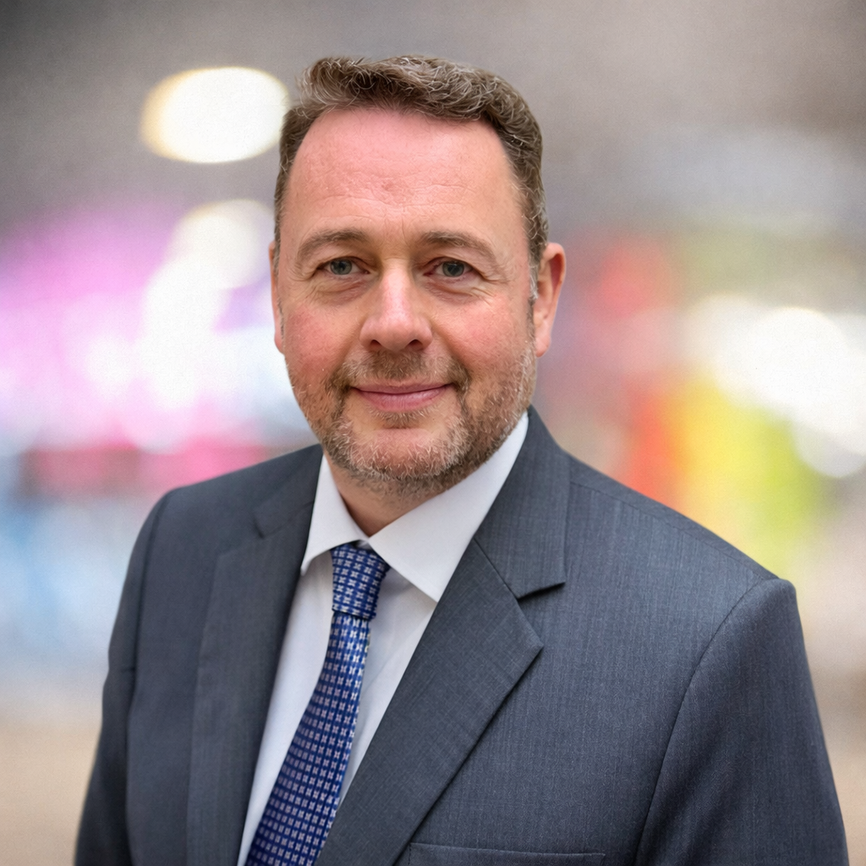

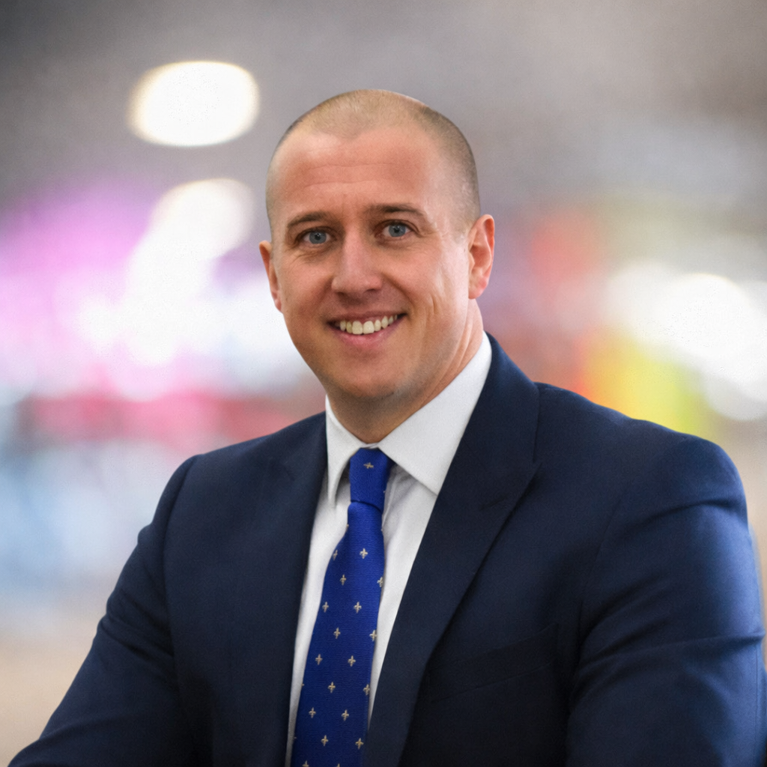
Meet some of the Executive Leadership Team
John Rigby
Michael Cauter
Louise Roberts
Andrew Melbourne
Executive Chair
Group CEO
Chief People Officer
Chief Financial Officer
Leading the strategic vision and growth of the group since the IPO in 2017, driving our expansion into new markets and service lines.
Overseeing group-wide operations and integration of acquired businesses, ensuring operational excellence across all brands.
Responsible for the Group’s people strategy, supporting growth while enabling colleagues to develop and fulfil their potential.
Responsible for financial strategy, governance, and investor relations, supporting the group's ambitious acquisition and growth plans.

Slide 16
Our locations
Our three principal offices in Bolton, London and Manchester anchor a national advisory platform, with specialist teams supporting clients across the UK.
Bolton
Manchester
London
K3 House
Springfield Court
Summerfield Road
Bolton
BL3 2NT
The Lexicon
3rd Floor
10-12 Mount Street
Manchester
M2 5NT
7th Floor
20 St Andrew Street
London
EC4A 3AG
info@k3advisorygroup.com

